Slide 1

Data Mining for Market Insights: Scraping EDGAR Filings and Linkedin Data for Technology Commercialization
Jacob Grippin

Slide 2
Outline
Welcome to Workshop. Introduce Instructor
Difference between APIs and Web Scraping
Introduce concepts of Web Scraping and APIs using Python
Live Coding Demo using Google Colab. Allows users to run Python code using jupyter notebook environment with no installation required. Participants able to follow along, run code and generate results in live time.
Example Web Scraping and API projects I have done.
CCSS additional resources for learning. Workshops, Consultations, etc.

Slide 3
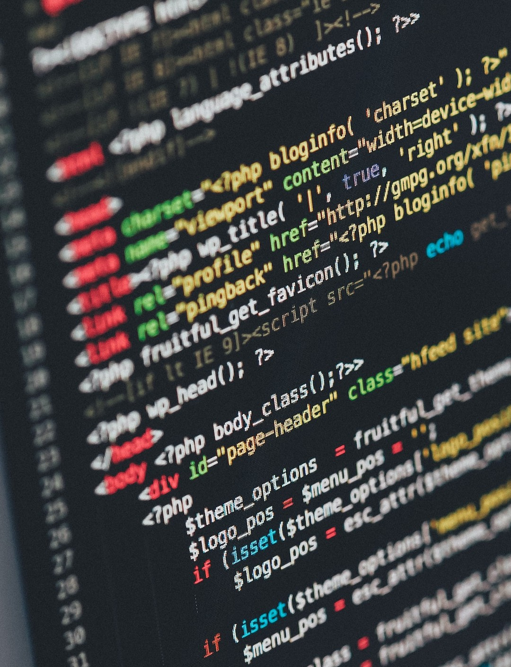

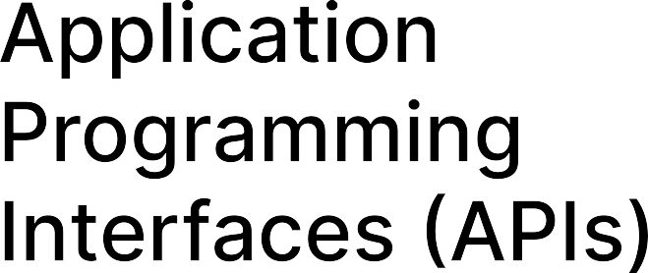
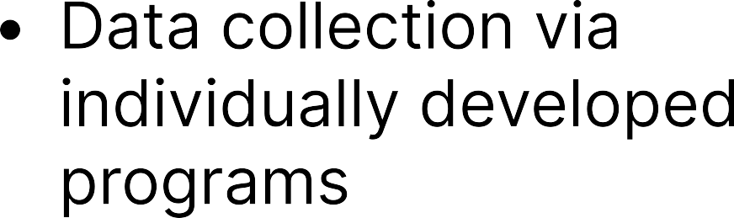

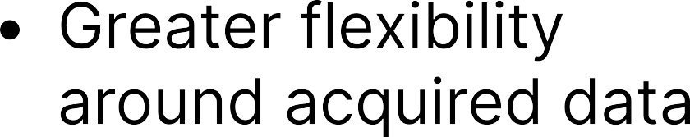
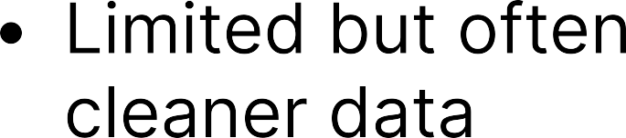
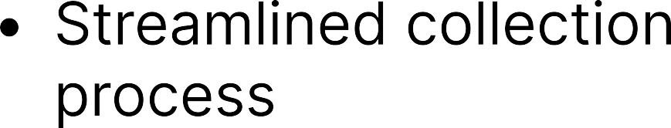
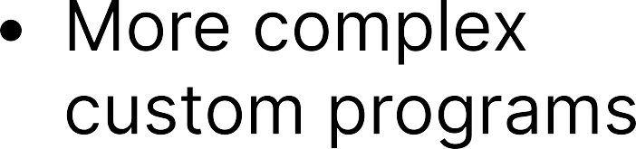

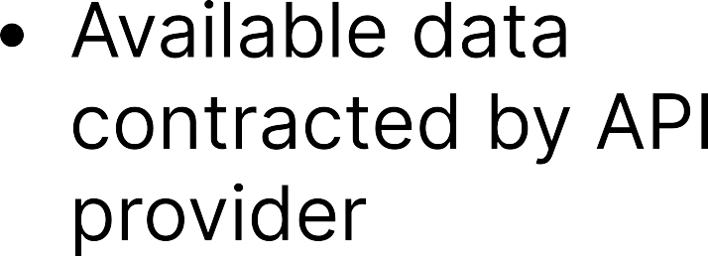
Web Scraping VS APIS

Slide 4
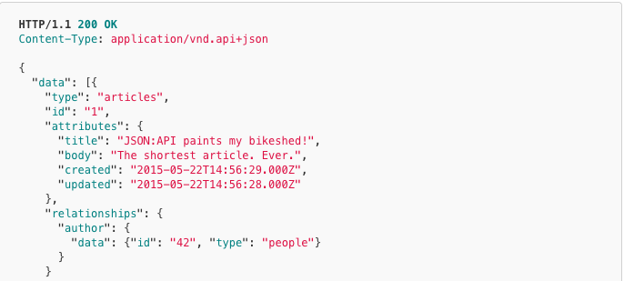
API Data (JSON Format)
Sample JSON data format.

Slide 5
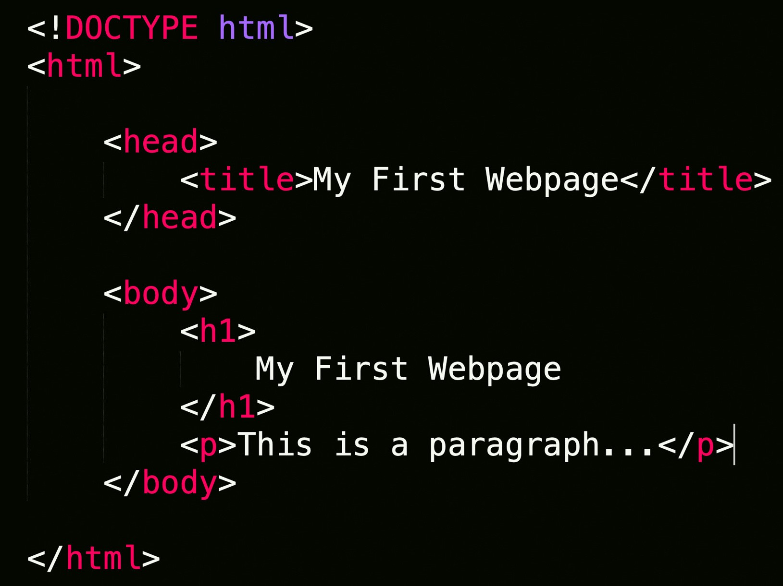
Web Scraping Data (HTML Format)
Extraction of data from a website.

Slide 6


Most User Friendly. Less flexible
Navigates static webpages. Not able to interact with webpage
More complex, but greater flexibility.
Navigates webpage interactively. Allows clicking, entering text, etc.

Slide 7
Other CCSS Resources
Programming/Coding Consultation, Data Consultation. For 1v1 or group trainings. Qualitative, Quantitative, Accessing and working with Data. (Python, R, Stata most popular)
CCSS Workshops. Recordings upon request. Email socialsciences@cornell.edu

